Slide 1
A Very Brief Introduction to the Semantics in LFG: Argument Structure and Glue Semantics
Wang Jiajun
Department of Chinese Linguistics, PKU

Slide 2
Outline
Argument Structure (how grammatical functions and semantic roles relate to each other)
Glue Semantics (the operating procedure of which resembles Categorial Grammar)

Slide 3
Part I: Argument Structure

Slide 4
Argument Structure
Syntax and semantics are separate structures, separately constrained.
Chris ate. (a two-place semantic relation with an intransitive use)
It rained. (requires a subject but denotes no semantic argument, e.g. *David rained. )
Syntax Testing: only intransitive verbs can participate in out-prefixation:
The lamp shines. /The lamp outshines the candle.
The Brownies found the treasure. / *The Brownies outfound the Girl Scouts in the treasure hunt.
Chris outate David.

Slide 5
Argument Structure
Semantic structure influences syntactic form:
Jim obliquated the door of the closet.
*The door of the closet obliquated Jim.
(obliquate: to build or place in an oblique orientation)
Since obliquate is a coined word, no syntactic or morphological priming effect may be activated during the experimentation. The unacceptability of the second sentence must be ascribed to constraints imposed by the verb. Alsina (1996), Chapter I
German example:
Ich esse den Äpfel. /Den Äpfel esse ich.
*Der Äpfel esse mich. /*Mich esse der Äpfel.
Notes:
语序固定（语法关系由语序呈现）的语言中，论元结构影响语序。语序自由（语法关系由形态变化呈现）的语言中，论元结构影响变格。

Slide 6
Argument Structure
What aspects of semantic structure are relevant for constraints on syntactic form?
Unrestricted Conceptual Representation: Any kind of semantic or culturally salient distinction can be reflected in syntax and constrain syntactic form and relations.
Grammatically Relevant Subsystem: Only certain semantic features represented as argument structure are relevant for syntax.
Pinker (1989), Mohanan (1994)
Work on LFG adheres to the “Grammatically Relevant Subsystem” paradigm.
Notes:
这个定义是无效的：A是啥？A是B。那B又是啥？
“广义配价模式”

Slide 7
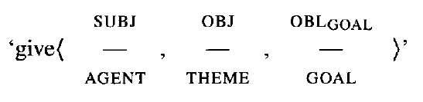
Argument Structure
Kaplan and Bresnan (1982)
Recent work on argument structure in LFG stems from two sources:
Proto-Role argument classification proposals of Dowty (1991)
Conceptual Semantics Framework of Jackendoff (1983, 1990)

Slide 8
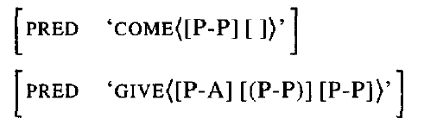
Proto-Role argument classification proposals of Dowty (1991)
Alsina (1996) assumes a set of criterial definitions for proto-agent and proto-patient argument:
A causer argument with volitional involvement is necessarily classified as a proto-agent.
An “incremental theme” argument is a proto-patient.
Arguments that do not meet these criteria are not assigned proto-role status.
Destination argument of come bears no proto-role status.
Recipient argument of give is optionally classified as a proto patient, depending on whether or not it is causally affected.

Slide 9
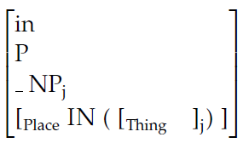
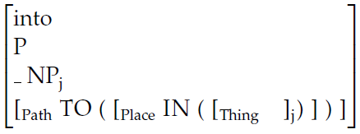
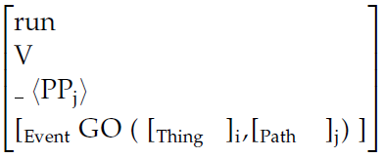
Conceptual Semantics Framework of Jackendoff (1983, 1990)
Conceptual Semantics Framework of Jackendoff (1983, 1990)
lexeme
POS category
selectional restriction
semantics

Slide 10
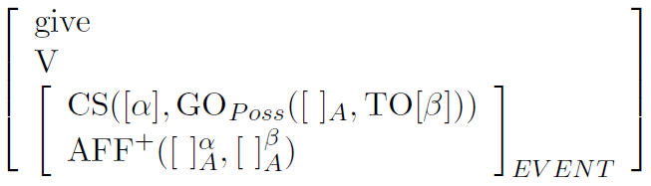
Conceptual Semantics Framework of Jackendoff (1983, 1990)
Lexical Conceptual Structure for give (Butt 1996)
Thematic Tier: “cause” relation CS holds between an actor α and an event GOPoss in which some entity is possessed by a beneficiary β.
Action Tier: encodes information about motion or location.
  (“+” introduces agent and beneficiary, while patient introduces agent and patient)
Aspectual Tier: indicates whether the beginning, middle and end of the event are lexically specified. (applied in polysynthetic languages such as Urdu)
ASP (___, ___, ___)

Slide 11
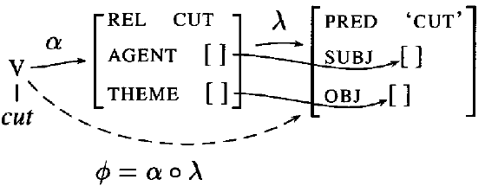
Conceptual Semantics Framework of Jackendoff (1983, 1990)
c-structure, f-structure and argument structure for cut (Butt et, al 1997)
α maps c-structure to a-structure, and λ maps a-structure to f-structure. Φ, composed from α and λ, maps c-structure to f-structure.
Butt et al. designed a theory to select the best candidate λ function.

Slide 12
Well-formedness Conditions
Subject Condition:
Every verbal lexical form has a subject.
(like EPP in GB)
Function-Argument Biuniqueness:
The association relationship between grammatical functions and semantic arguments must be one-to-one.
(like theta-Criterion in GB)
Notes:
EPP是说，TP的specifier位置上必须要有CP或DP，而不是每个句子都要有主语。
Theta-Criterion是说，跟语义角色一一对应的是短语结构，而不是主语谓语这样的语法功能。
不过，他们说的可能是一回事。

Slide 13
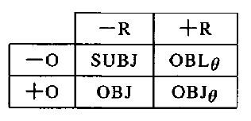
Lexical Mapping Theory (Bresnan and Kanerva 1989)
Syntactic functions SUBJ, OBJ, OBJθ, OBLθ can be decomposed into features ±R(estricted) and ±O(bjective).
-R: semantically unrestricted functions SUBJ and OBJ: arguments with any or no thematic role can enter.
+R: semantically restricted functions OBJθ and OBLθ: only argument with certain thematic role may enter. (e.g. AGENT enter OBLAGENT)
-O: non-objective functions SUBJ and OBLθ.
+O: objective functions OBJ and OBJθ.

Slide 14
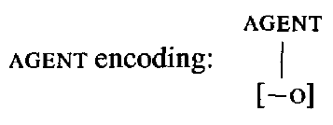
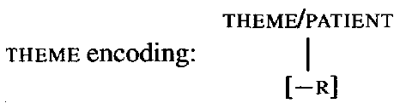
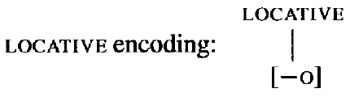
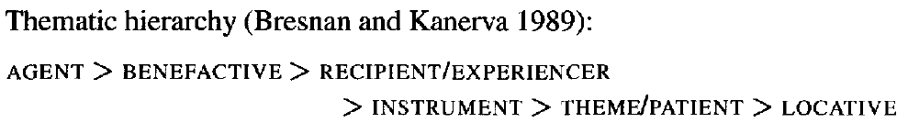


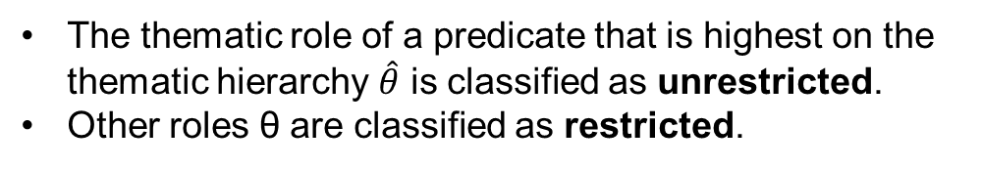
Lexical Mapping Theory (Bresnan and Kanerva 1989)
Intrinsic Classification
Default Classification
The thematic role of a predicate that is highest on the thematic hierarchy $\hat{θ}$ is classified as unrestricted.
Other roles θ are classified as restricted.

Slide 15


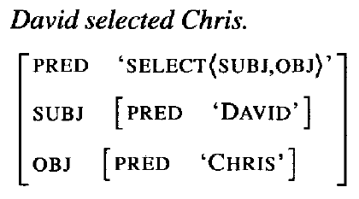
The Active/Passive Alternation
David selects Chris.
Intrinsic classification supresses
default classification

Slide 16




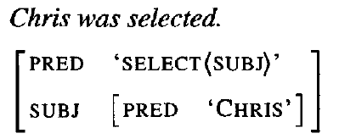
The Active/Passive Alternation
Chris is selected.
Bresnan and Moshi (1990) propose that passivization serves to suppress the thematically highest argument, making it unavailable for linking. (AGENT will be linked to modifying adjunct. )
Default classification assigns [+R] to patient, which is suppressed by intrinsic classification.

Slide 17
Part II: Glue Semantics

Slide 18
Glue Semantics
Argument structure alone is not enough to represent meaning, e.g. scope of modifier, quantification and notions of co-reference.
The order in which meaning is combined does not necessarily reflect constituent structure. LFG relates meaning to f-structure, not c-structure.
Standard predicate logic with function abstraction/application and variable binding is used in this approach.

Slide 19
Glue Semantics
Predicate Logic
constant: David one-place function: yawn
one-place function applied to a constant: yawn(David)
Lambda Abstraction
λX.P represents a function from entities represented by X to entities represented by P.
When P contains at least one occurrence of X, we say that these occurrences are bound by the λ lambda operator. e.g. λX.person(X).
Function Application
[λX.P] (α): The function λX.P is applied to the argument α. e.g. [λX.yawn(X)] (David) ≡ yawn(David)

Slide 20
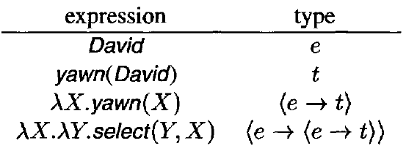
Glue Semantics
Types
The expressions we work with are typed.
e (entity) is associated with individual-denoting expressions, t (truth value) is associated with proposition-denoting expressions.

Slide 21


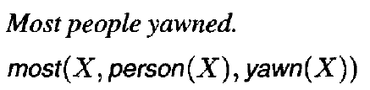
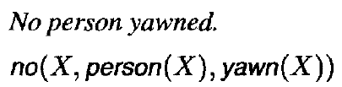
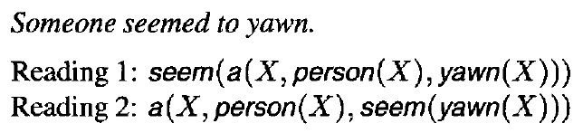
Glue Semantics
Quantification
The first proposition is restriction, which is syntactically fixed.
The second proposition is scope, which is chosen more freely and may cause semantic ambiguity.

Slide 22
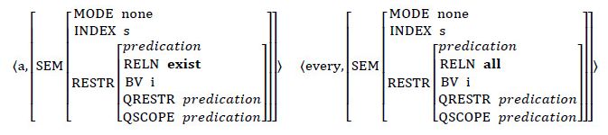
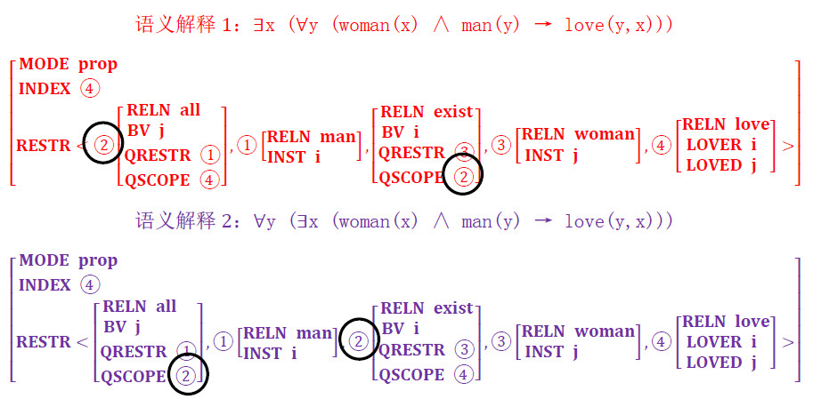
Restriction and Scope reminds me of something similar in HPSG……

Slide 23


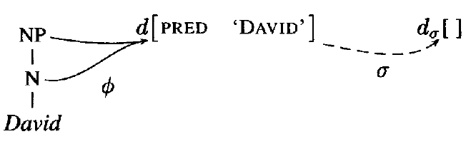
Glue Semantics
Notes:
孙老师不看好AMR，可能是因为她觉得AMR缺少学术沉淀。
这次准备Glue Semantics，就发现这背后其实有深厚的逻辑学底蕴，包括范畴语法、内涵逻辑等等，有一个学术传统在背后支持着，而不是根据具体问题临时设计出的一个模型。

Slide 24


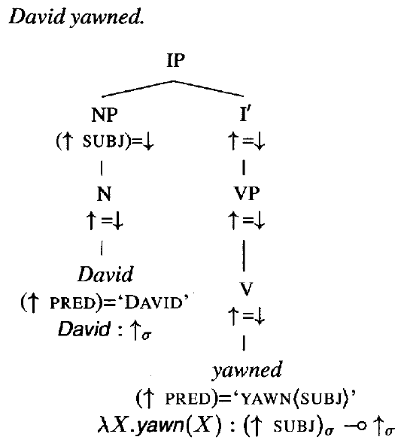
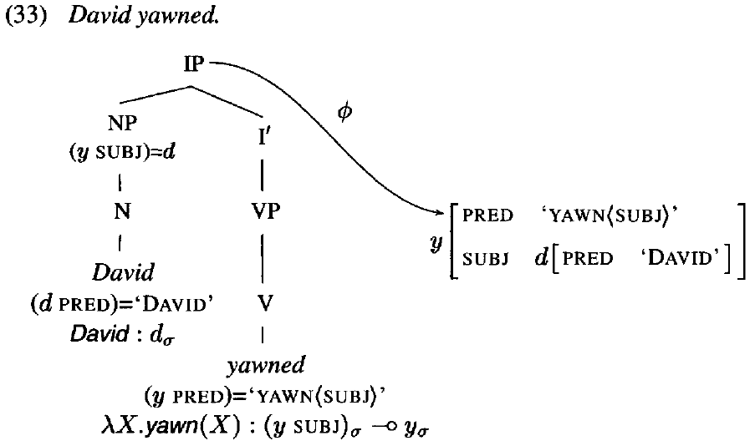
Example 1: Intransitive Verb

Slide 25
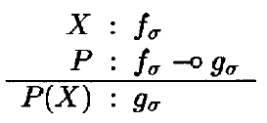
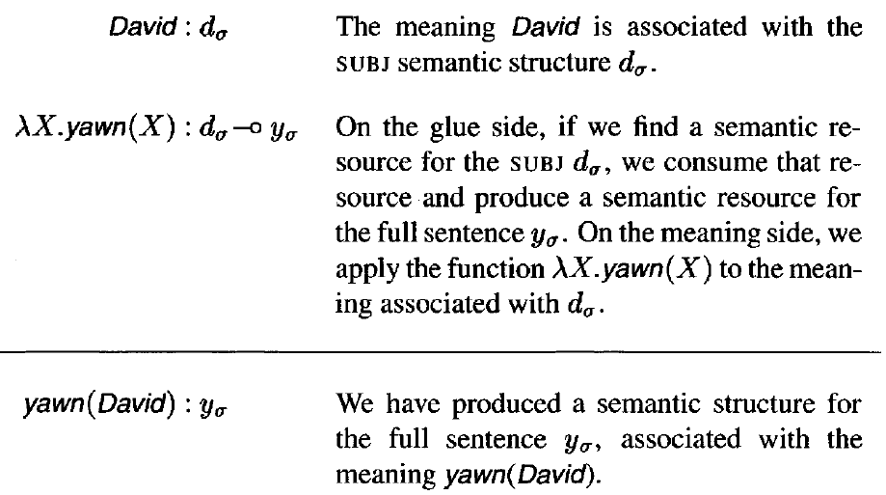
Example 1: Intransitive Verb

Slide 26

Example 2: Transitive Verb

Slide 27
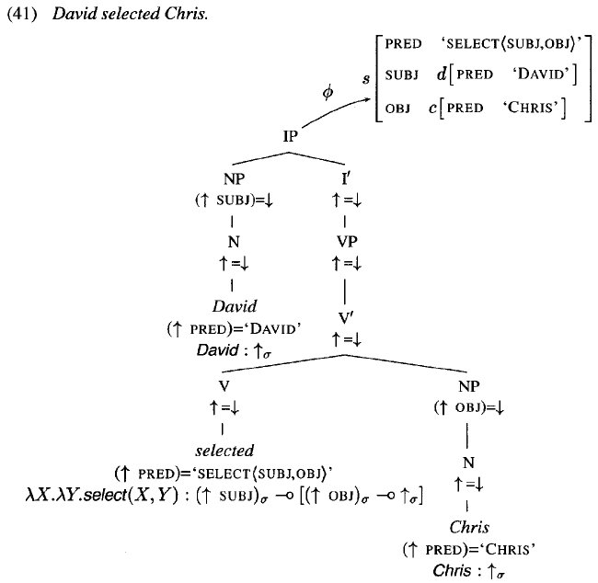

Slide 28
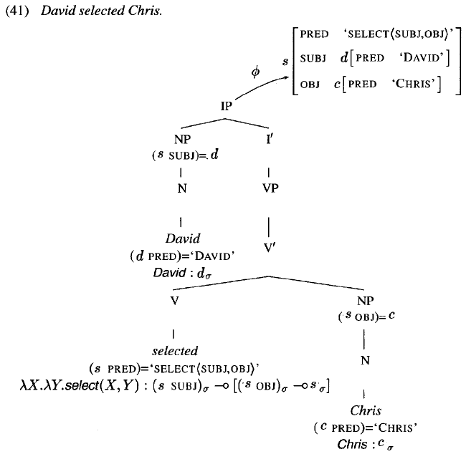

Slide 29
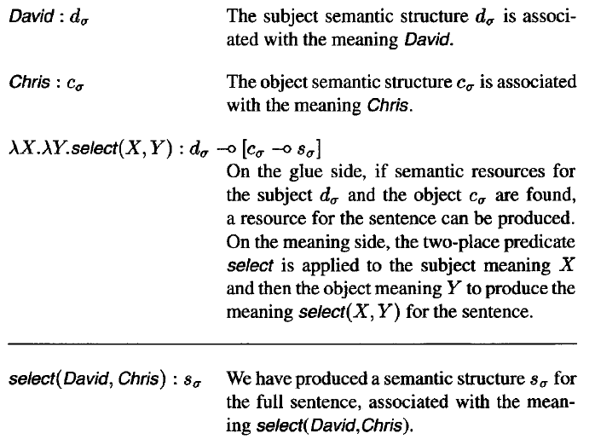
Example 2: Transitive Verb

Slide 30
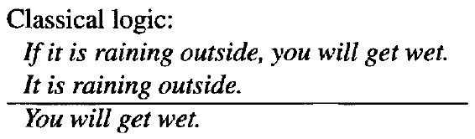
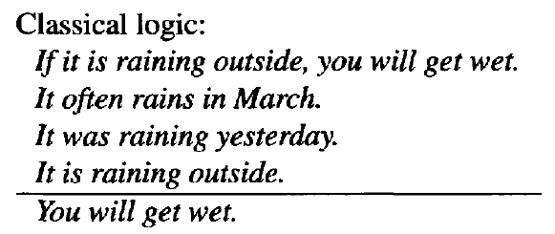
The “Glue” Language: Linear Logic

Slide 31

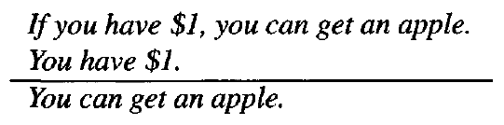
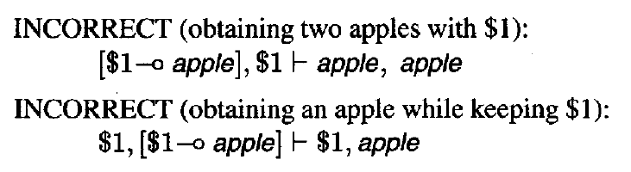
The “Glue” Language: Linear Logic

Slide 32
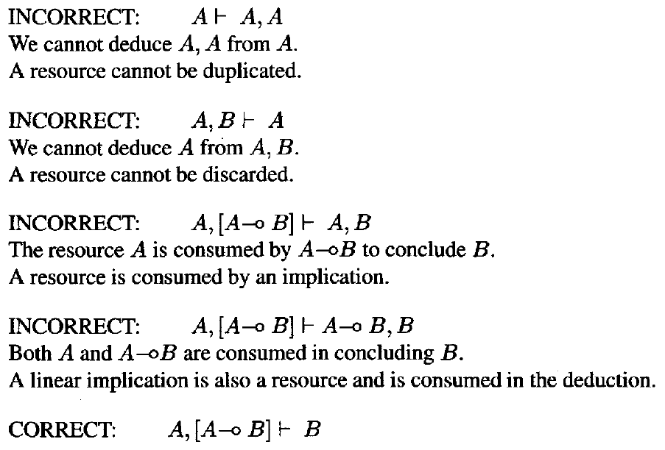
The “Glue” Language: Linear Logic

Slide 33
Semantic Completeness and Coherence
A meaning derivation for an utterance is semantically complete if a meaning derivation from the premises…produces a meaning…that does not contain any unsaturated expressions.
A meaning derivation for an utterance is semantically coherent if the meaning derivation produces a meaning…with no additional unused premises remaining.
Semantically incomplete: A, [A→[B→C]]├ [B→C] e.g. *David selected.
Semantically incoherent: A, B, [A→C] ├ B, C e.g. *David yawned Chris.
Semantically coherent and complete: A, [A→B] ├ B e.g. David yawned.

Slide 34
The “Glue” Language: Linear Logic
This aspect of glue semantic deductions is strongly similar to Categorial Grammar (Oehrle et al. 1988; Moortgat 1988, 1996; Morrill 1994; Steedman 1996).
Linguistic analysis in Categorial Grammar is a deductive process, in which the syntactic structure and the meaning of a sentence are obtained by a logical deduction from premises contributed by its words.
Notes:
Deduction: 推导，扣除。

Slide 35
The “Glue” Language: Linear Logic
Probably the most important difference between the categorial approach and the glue approach is in the syntactic primitives that are relevant for semantic composition.
In categorial grammar, a predicate combines with its arguments on the basis of relations defined on the surface string, like to-the-left-of and to the-right-of.
In the glue approach, in contrast, semantic deductions are guided by f-structural relations like SUBJ, COMP, and ADJ.
This frees the glue approach from concerns with cross-linguistically variable constituent structure relations and allows semantic composition to proceed according to the more abstract syntactic organization of f-structure.

Slide 36
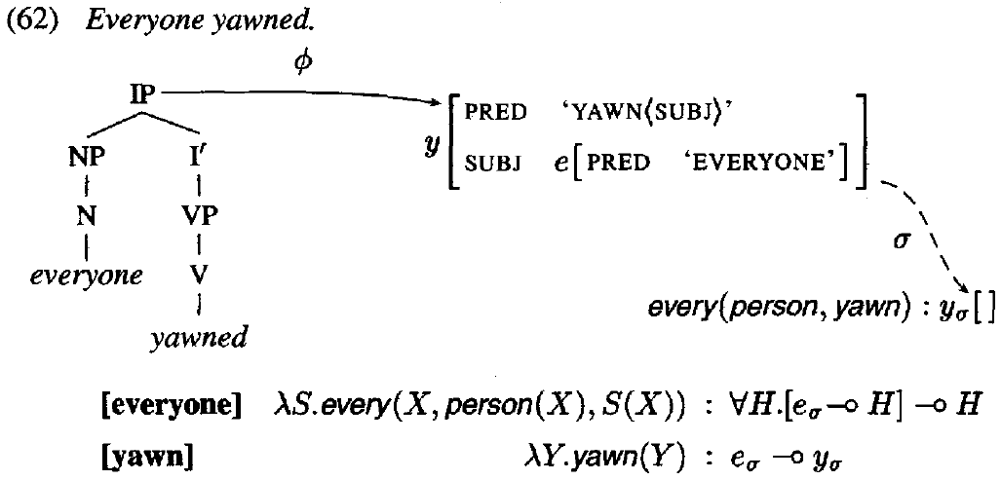
Quantification: everyone

Slide 37
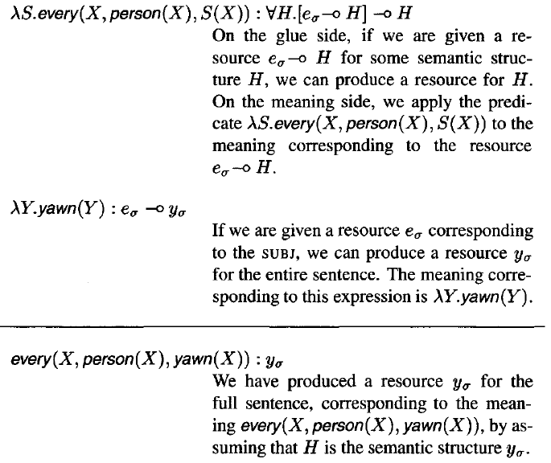
Quantification: everyone

Slide 38
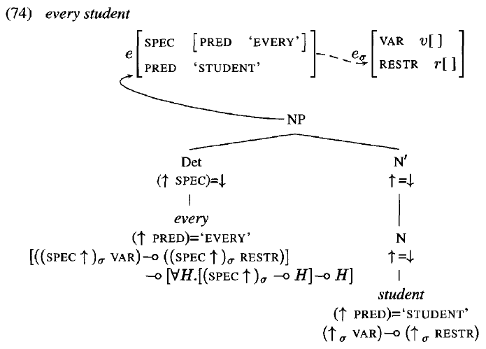
Quantification: every

Slide 39
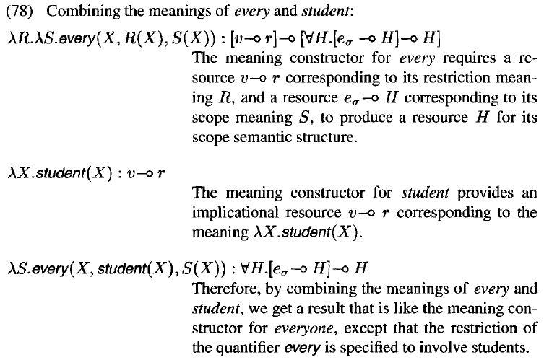
Quantification: every

Slide 40
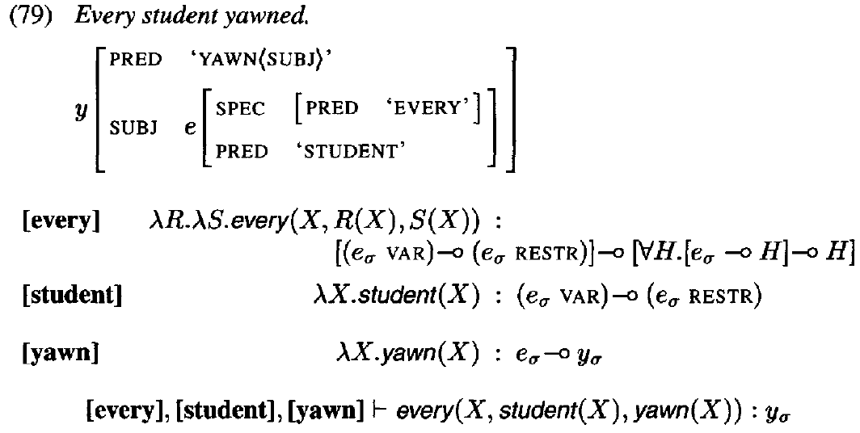
Quantification: every

Slide 41
Thanks for your Attention !
Q & A

